Slide 1
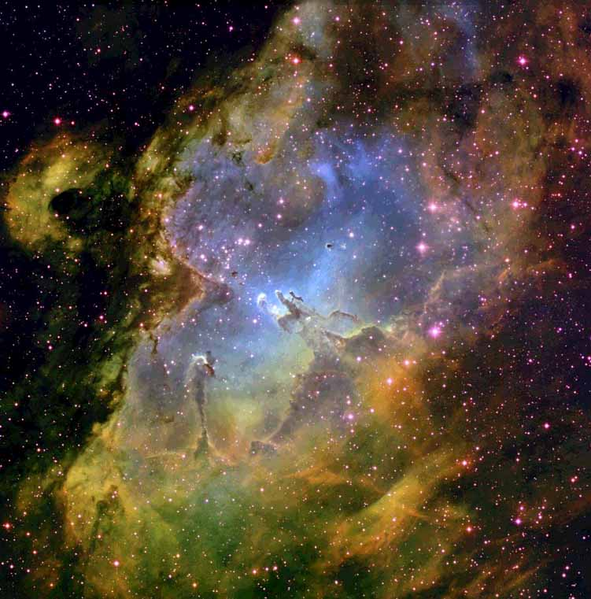
Kosmisk Støv
Anja C. Andersen
Dark Cosmology Centre
Niels Bohr Institutet
Københavns Universitet
http://www.dark-cosmology.dk/~anja

Slide 2
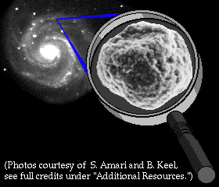
Min Forskning = Stjernestøv

Slide 3
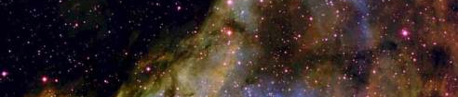
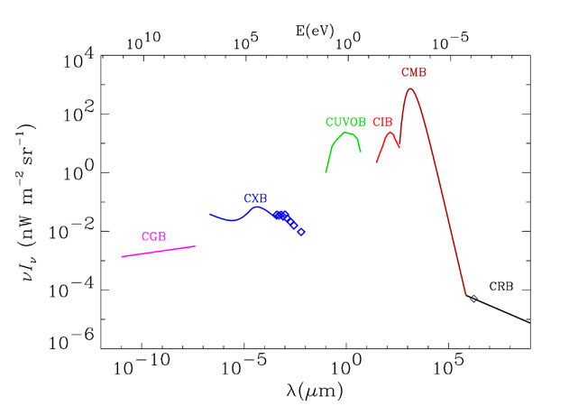
Kosmisk baggrund stråling
microwave
gamma
X-ray
optical
IR
radio
Flux
Støv
Wavelength
Hauser & Dwek 2001
Notes:
Spectrum of the cosmic background radiations. The radio background (CRB) is represented by a I ^{0.3} spectrum, normalized to the Bridle (1967) value at 170 cm. The cosmic microwave background (CMB) is represented by a blackbody spectrum at 2.725 K. The UV-optical (CUVOB) and infrared (CIB) backgrounds are schematic representations of the work summarized in this review (see Figure 5). The data for the X-ray background (CXB) are taken from Wu et al. (1991), and the curves are analytical representations summarized by Fabian & Barcons (1992). The -ray background (CGB) is represented by the power law given by Sreekumar et al. (1998).

Slide 4
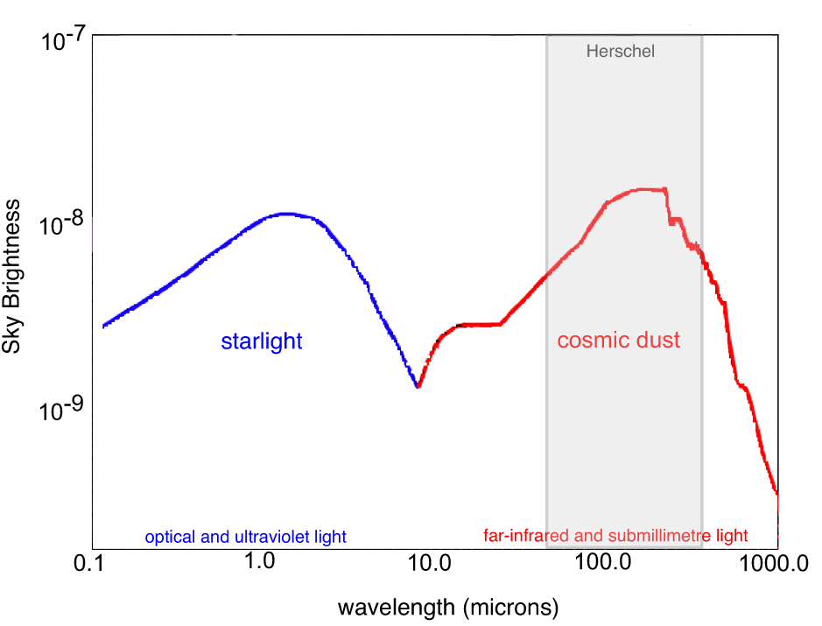
Mængden af lys fra stjernerne = mængden af lys fra støvet
optisk
infrarød
Notes:
half the energy bduget in IR

Slide 5
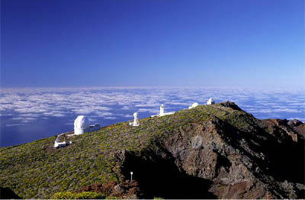
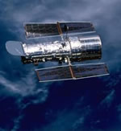
Astronomi
Astronomer arbejder med at undersøge og forstå universet. Arbejdsredskaber er kikkerter, satellitter og computere.

Slide 6
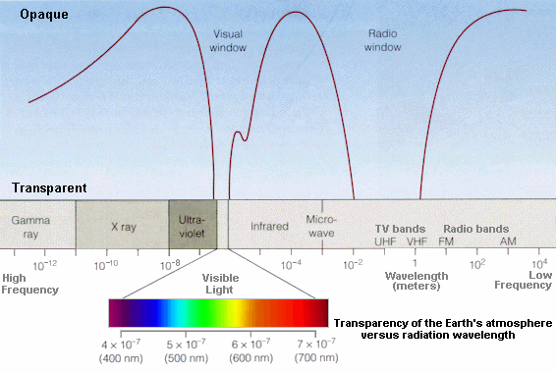
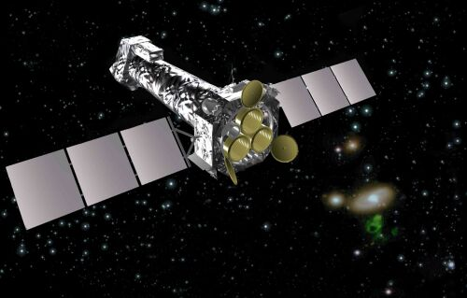
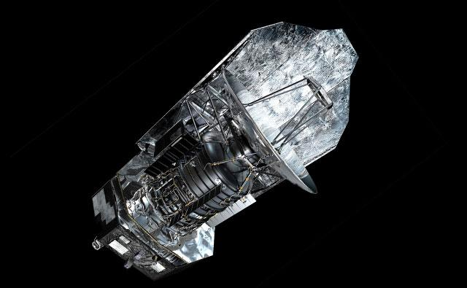
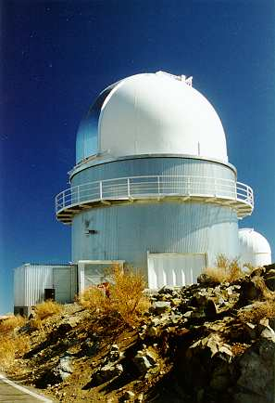
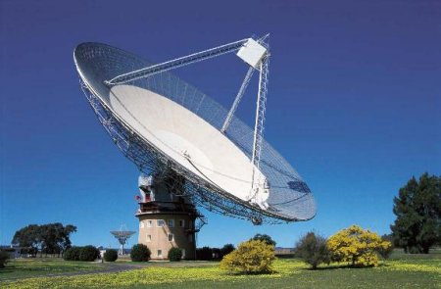
Jordens atmosfæres gennemsigtighed

Slide 7
Ørnetågen

Slide 8
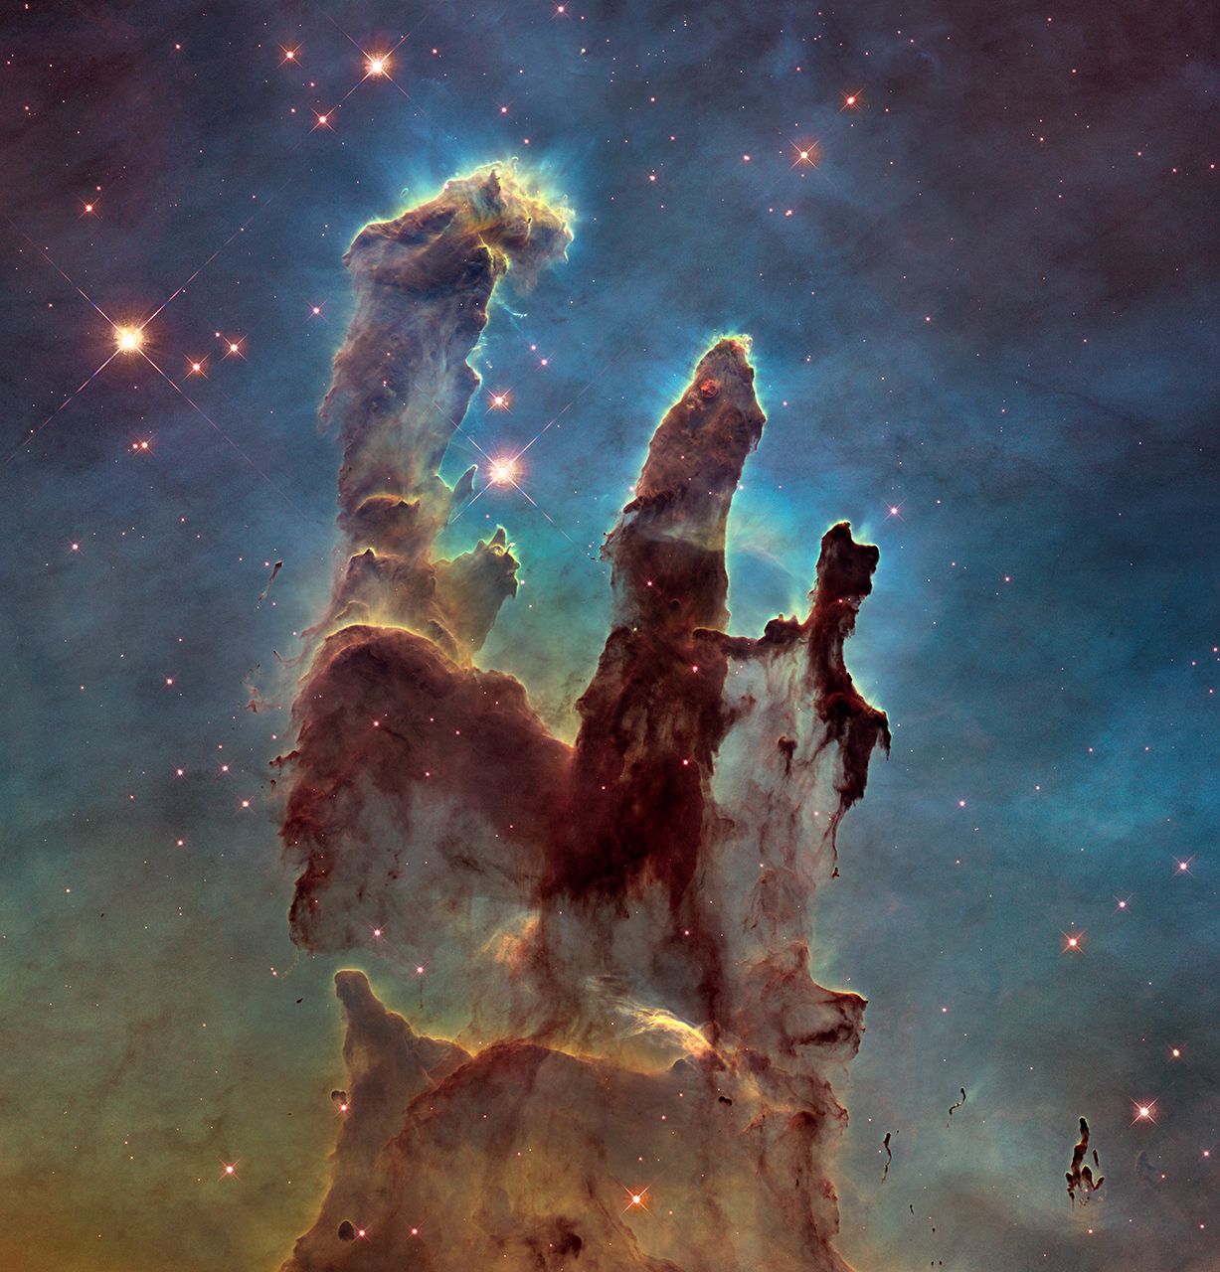
M16 i synligt lys

Slide 9
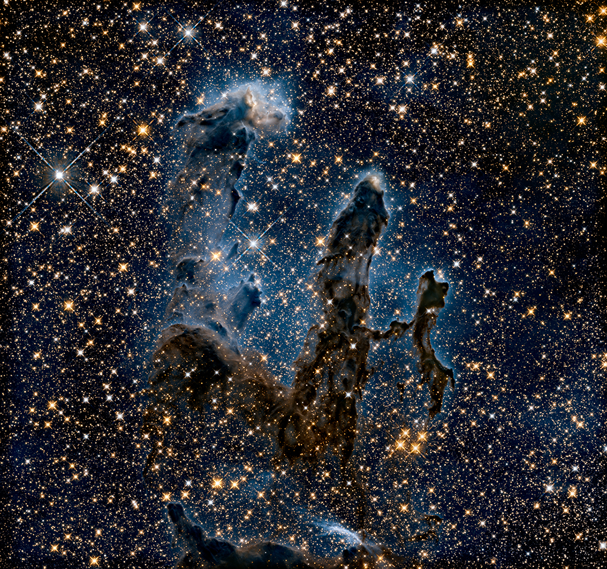
M16 i infrarødt lys

Slide 10
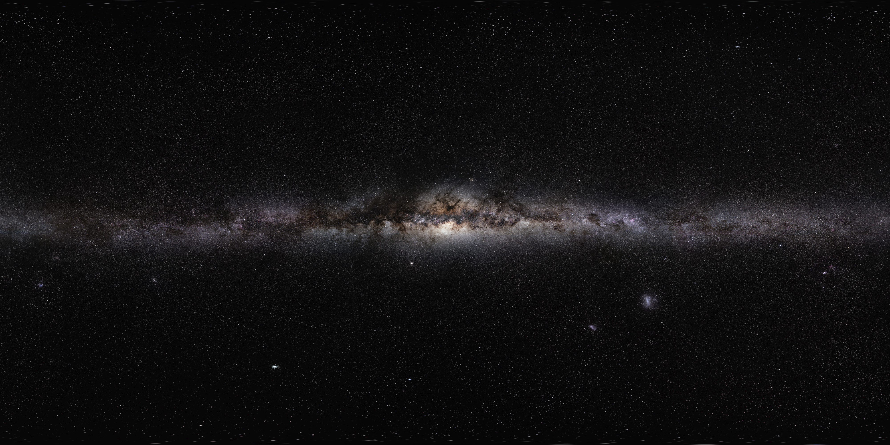
Mælkevejen

Slide 11
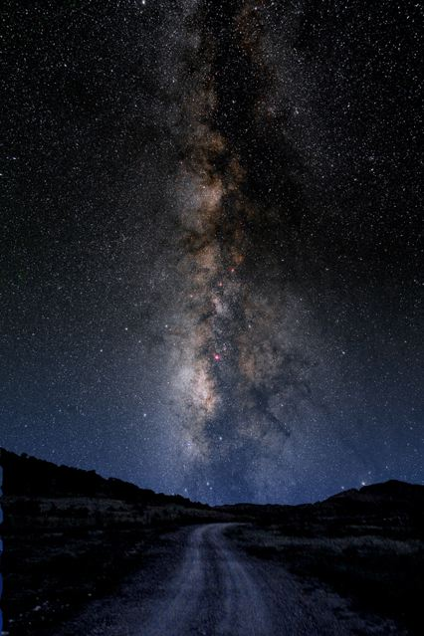
Interstellar
Matter
Matters !
The centre of the Milky Way would be a billion times brighter if not for cosmic dust...
Notes:
Figure 18-1. Milky Way Mosaic The Milky Way Galaxy photographed almost from horizon to horizon, thus spanning nearly 180°. This band contains high concentrations of stars, as well as interstellar gas and dust. The gray box shows the field of view of Figure 18.5. (Axel Mellinger)

Slide 12
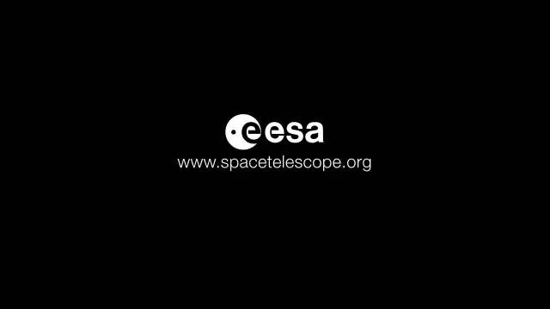

Slide 13
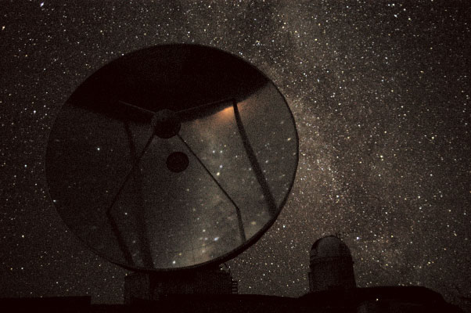
Kosmisk Støv - ”de hårde fakta”
Omkring 1/5 af den del af Mælkevejens masse der består af stjerner, planeter og andet “baryon stof” er i form af gas og støv. Af denne 1/5 er 99% gas og 1% støv.
Røgpartikler der formentlig består af C, O, Si, Mg, Al, Fe.

Slide 15
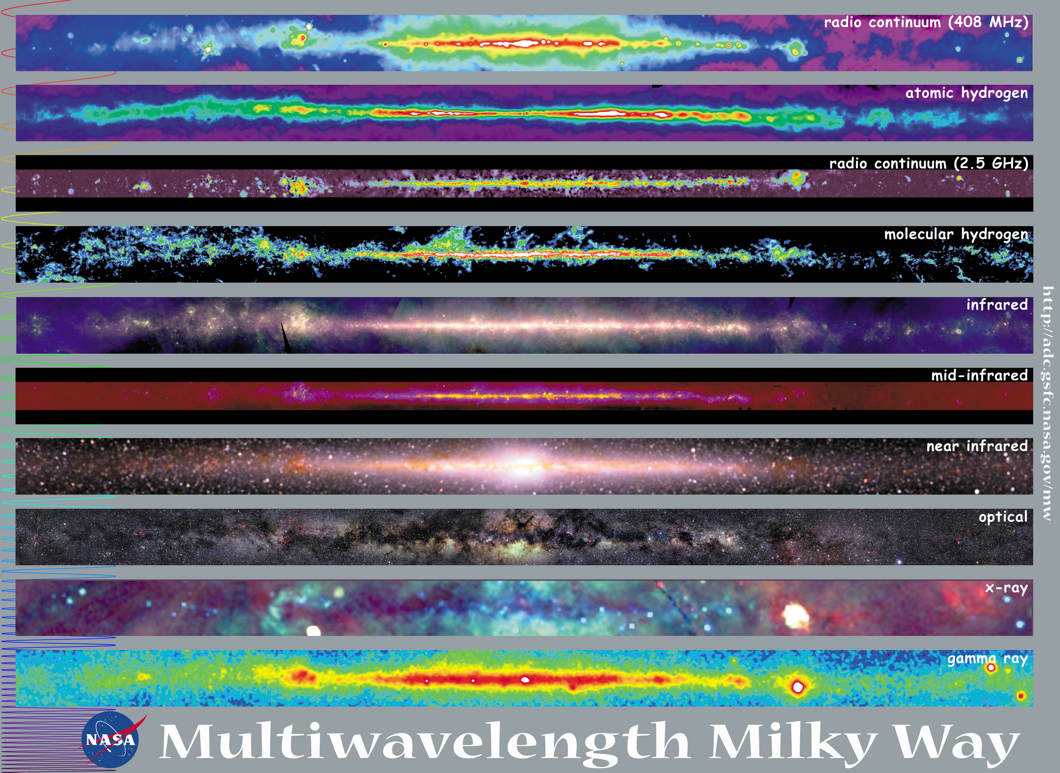
Multiwavelenght MW

Slide 16
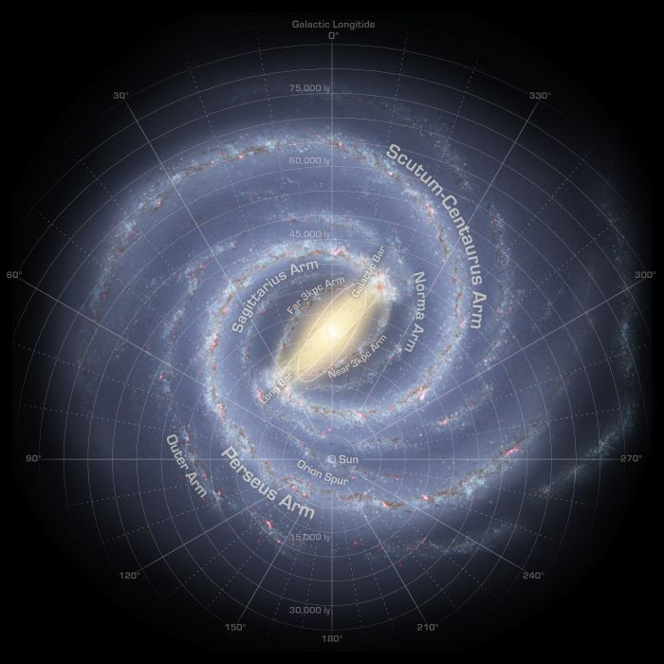
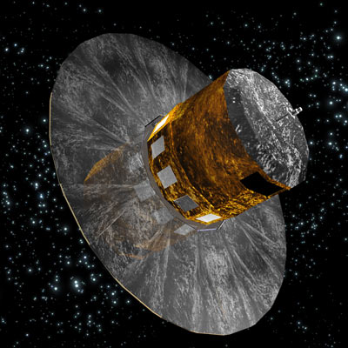
Mælkevejen
model
GAIA launch December 2013

Slide 17
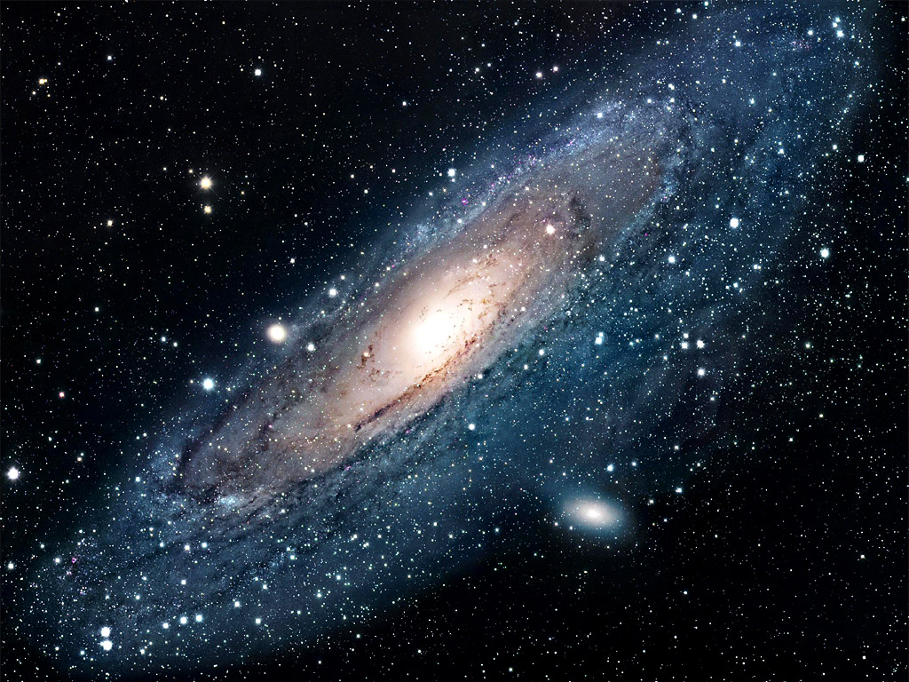
Andromeda galaksen
2,4 millioner lysår

Slide 18
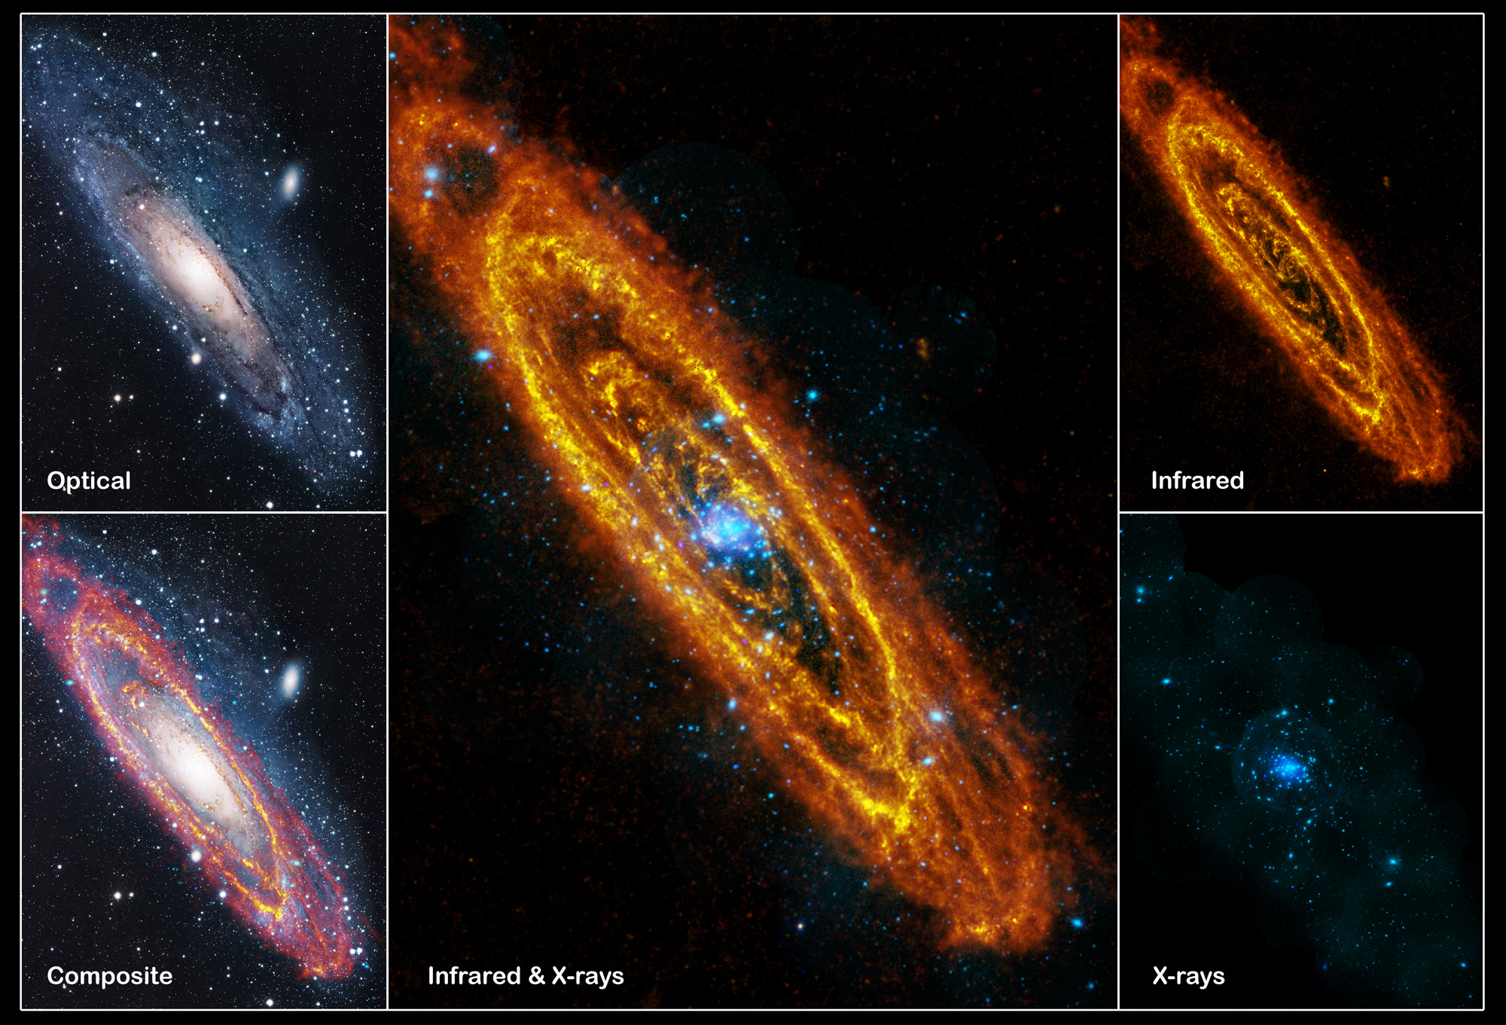

Slide 19
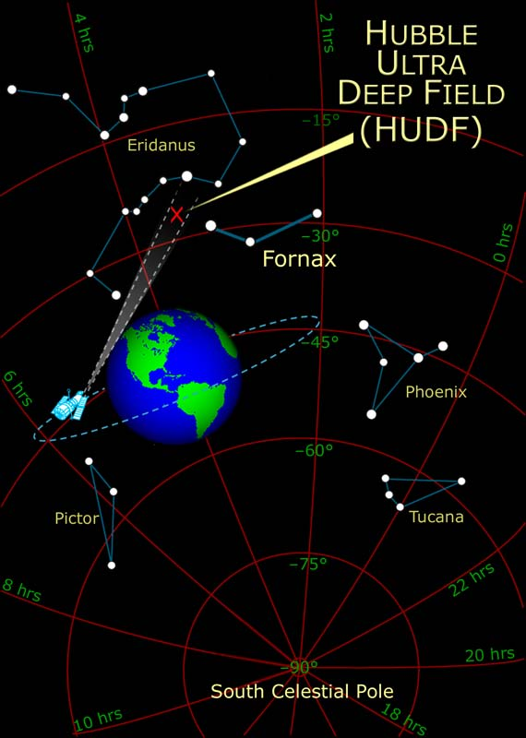
Hubble Ultra Deep Field:
11 døgns eksponeringstid en tidsmaskine!

Slide 20
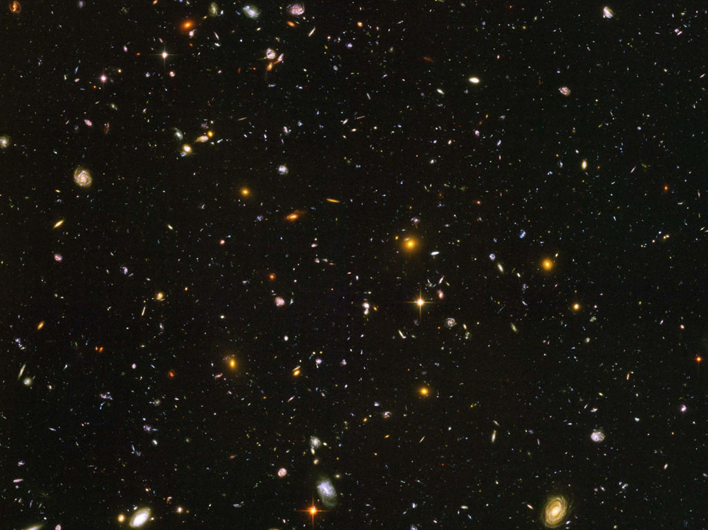
Hubble Ultra Deep Field:

Slide 21
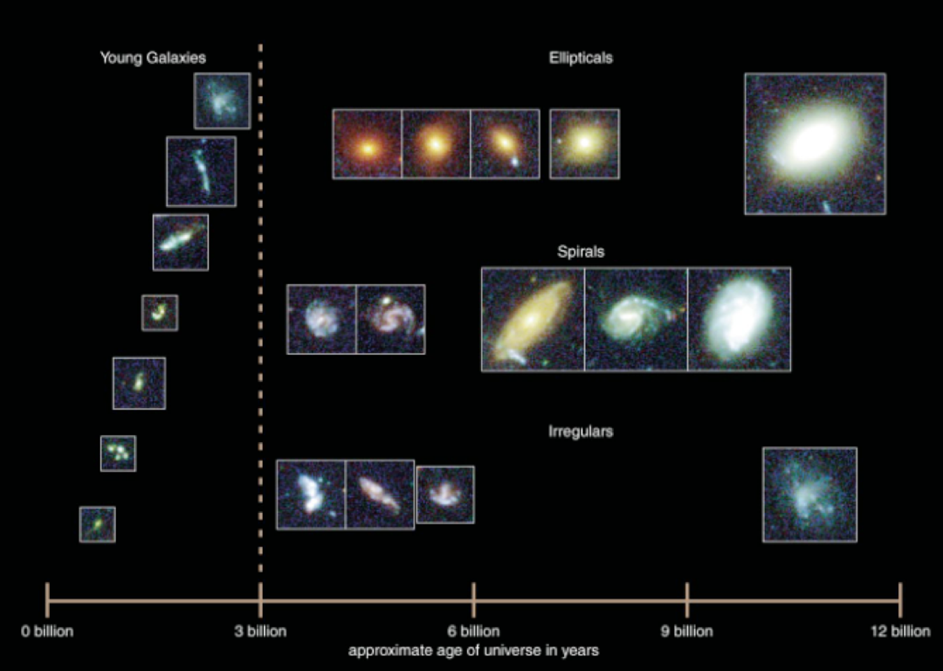

Slide 22
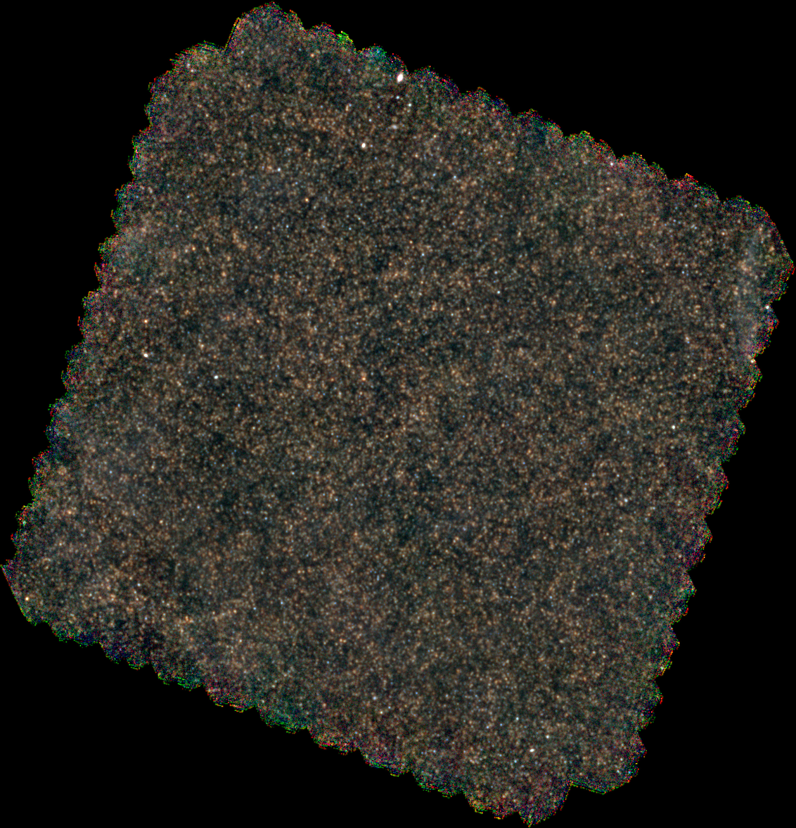
Herschels infrarøde observationer af fjerne galakser
Infrarød

Slide 23
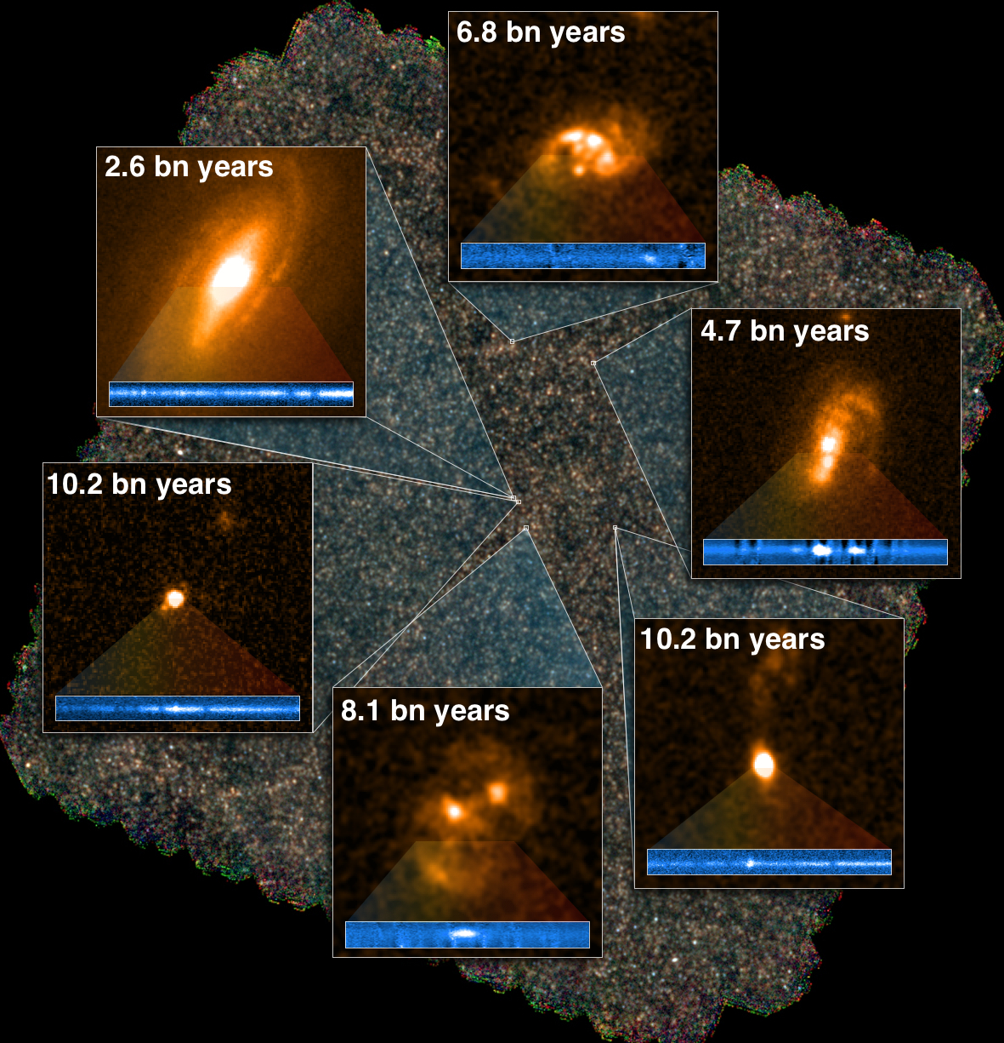
Infrarød

Slide 24
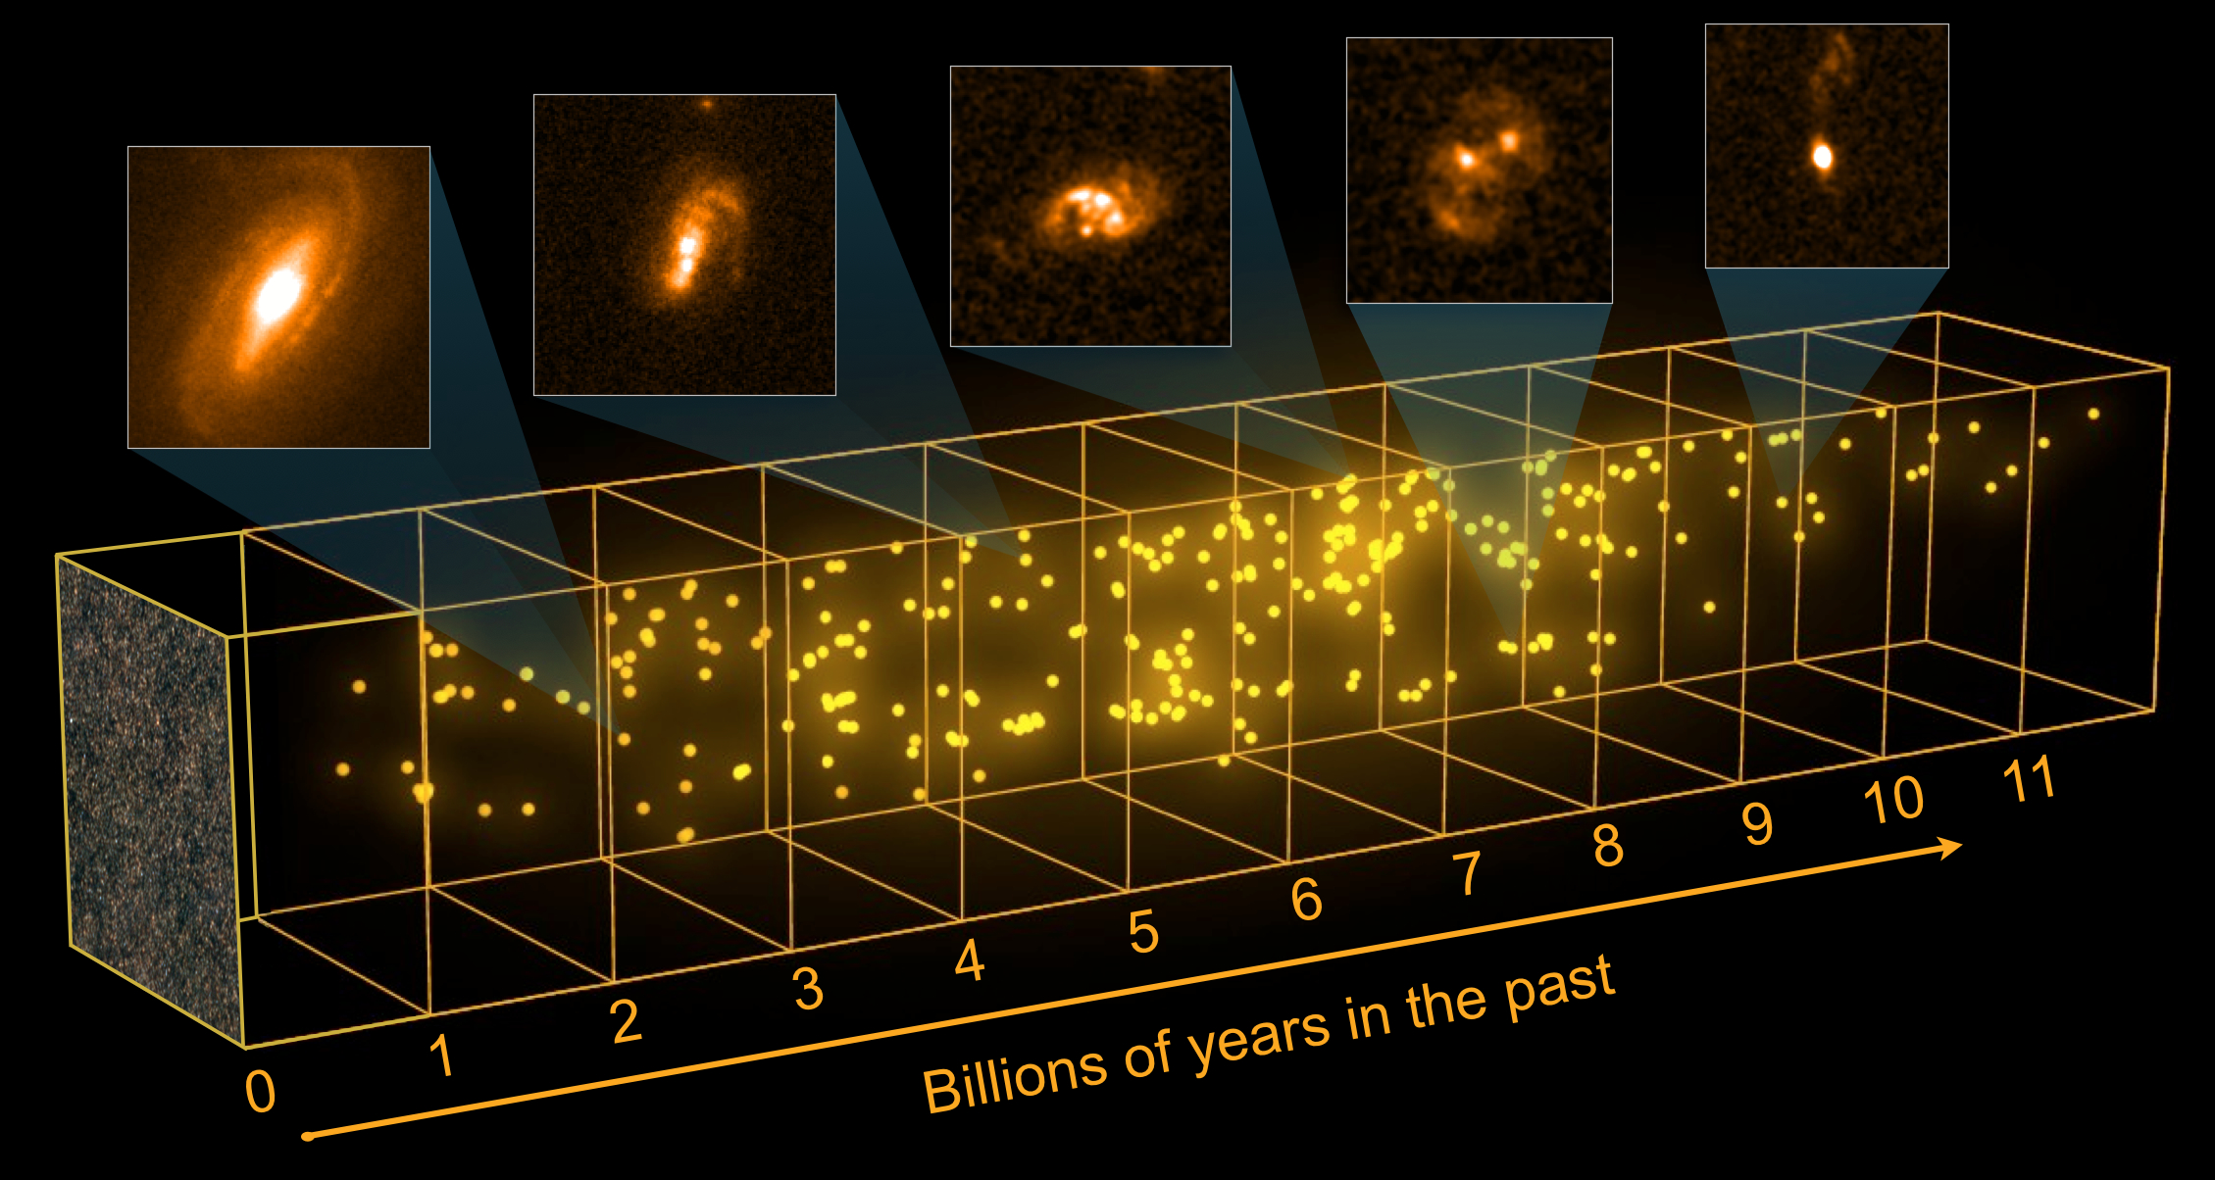
Infrarød

Slide 25
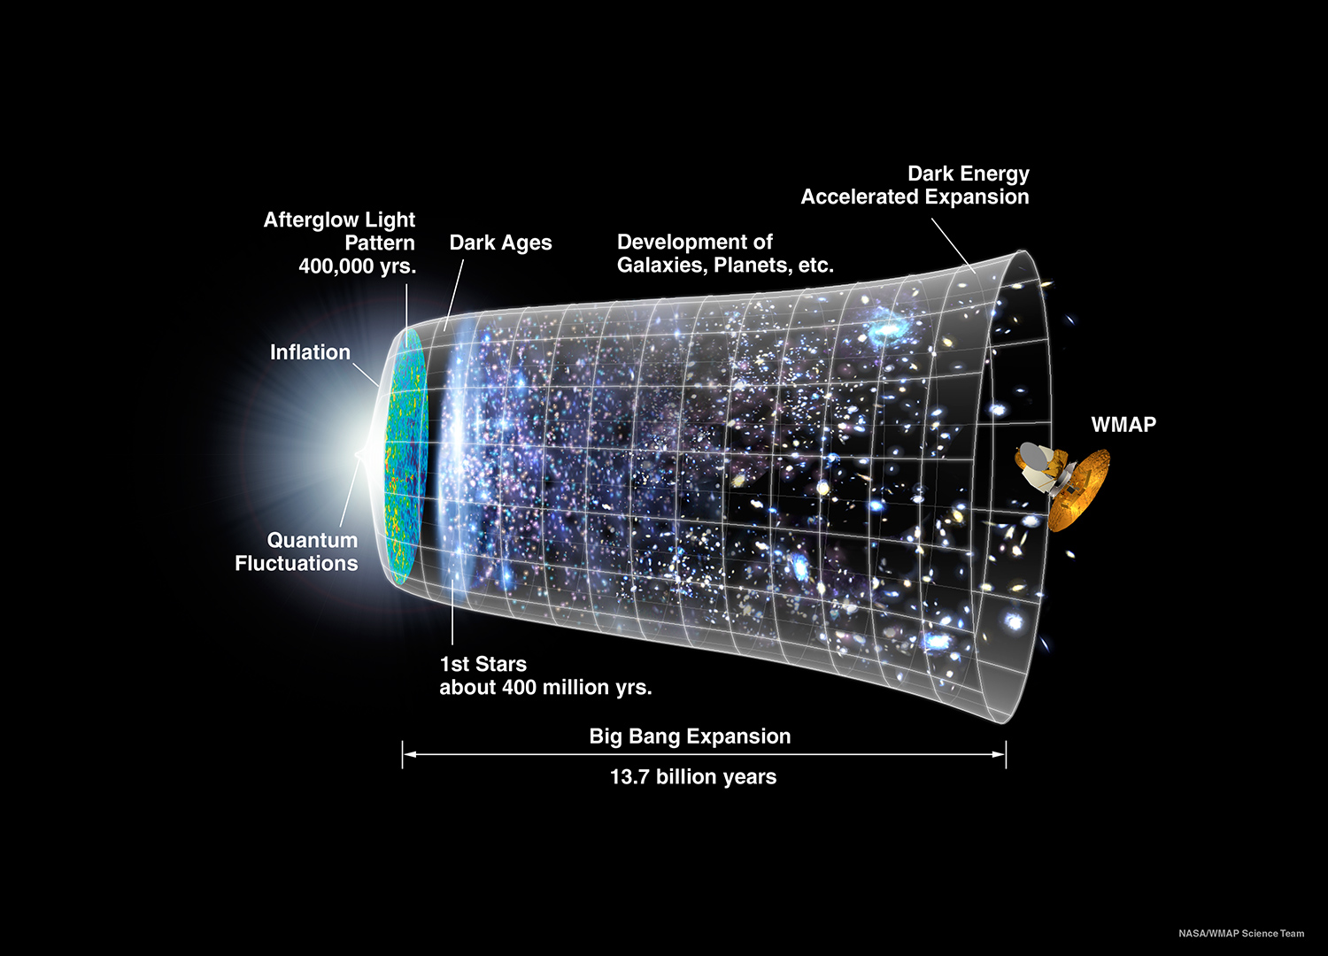

Slide 26
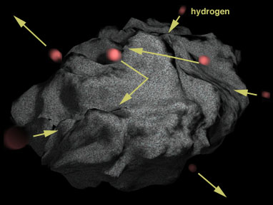
Støvets betydning

Slide 27
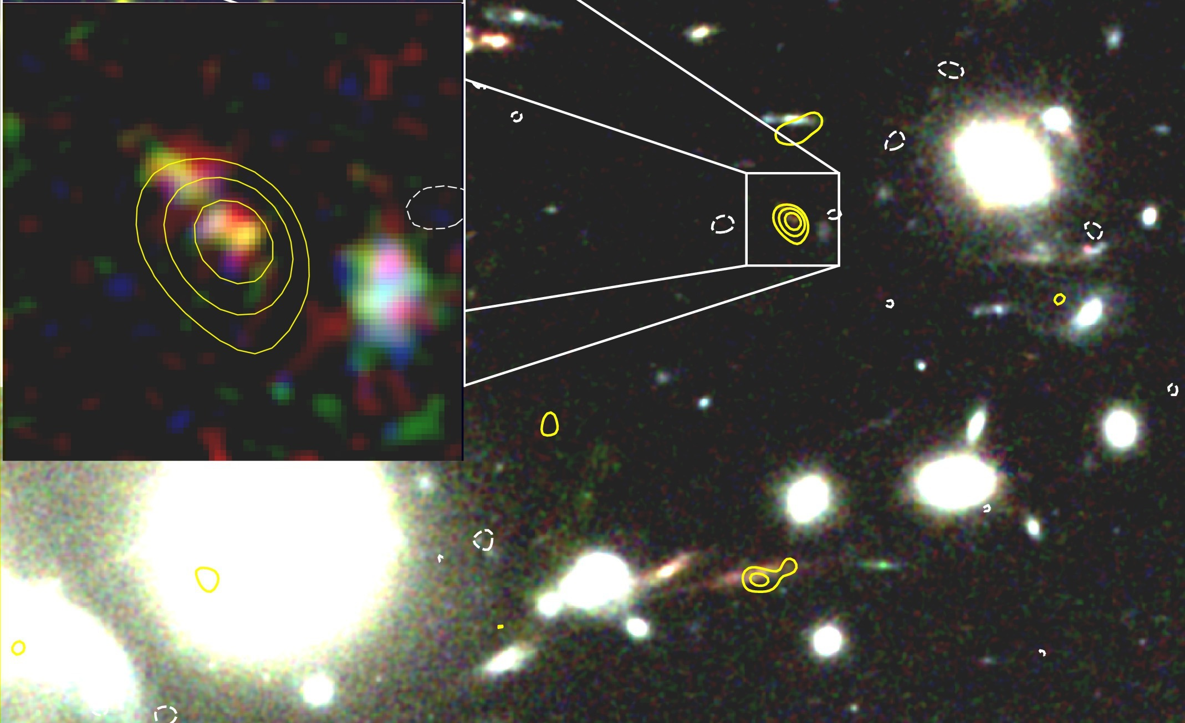
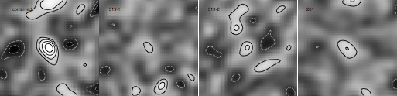
ALMA and VLT observations of the cluster lensed dust galaxy at z=7.4. Dust mass 4x10⁷ M_{sun}
Watson et al. 2015 GHz

Slide 28
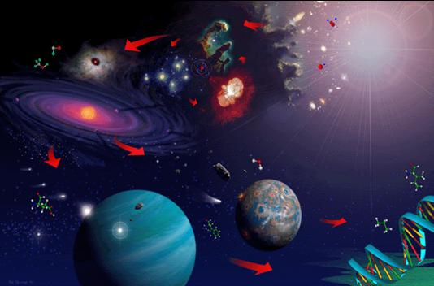
Afslutning

